Slide 1
Digital Image Processing CSC331
Color Image Processing

Slide 2
Summery of previous lecture
Color image processing
Primary and secondary colors
Color characteristics
Chromaticity diagram and its use
Color models
RGB color model

Slide 3
Todays lecture
RGB color model
CMY model
HSI color model
Pseudocolors image processing
Full color image processing

Slide 4
Color model
RGB model or red, green blue model
image displays like monitor
CMY model: cyan, magenta and yellow
useful for image printer
CMYK model: cyan, yellow magenta and black.
useful for image printers
HSI color model: hue, saturation and intensity or brightness
application oriented or also, it is perception oriented. That is how we perceive a particular color

Slide 5
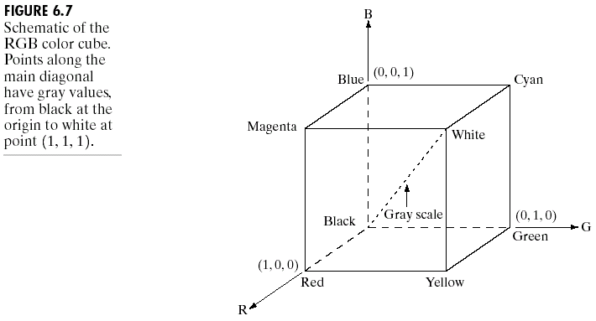
Color Models -- RGB Model
RGB color model is based on Cartesian coordinate system

Slide 6
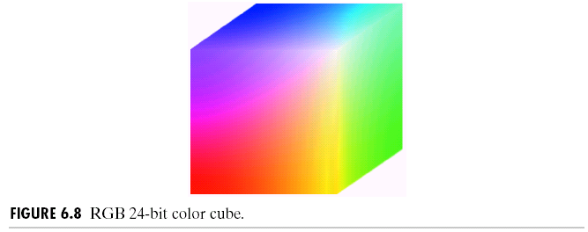
Color Models -- RGB Model
True color supports 24-bit for three RGB colors. It provides a method of representing and storing graphical-image information (especially in computer processing) in an RGB color space such that a very large number of colors, shades, and hues can be displayed in an image, such as in high-quality photographic images or complex graphics.
Usually, true color is defined to mean 256 shades of red, green, and blue, for a total of 224 or 16,777,216 color variations. The human eye can discriminate up to ten million colors.

Slide 7
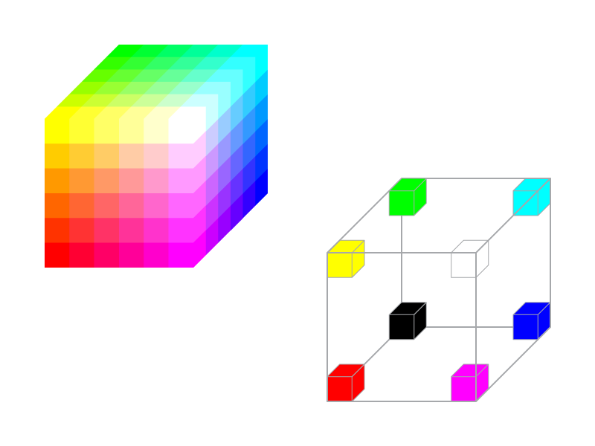
Safe RGB Color Cube

Slide 8
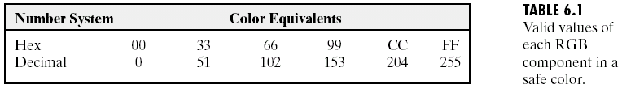
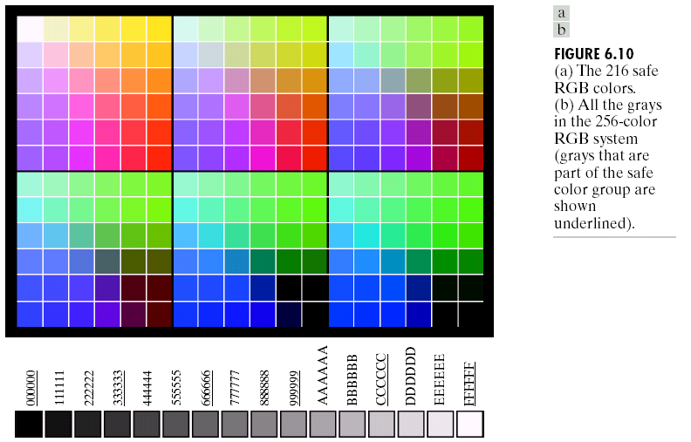
Color Models -- RGB Model
For most graphics images used for Internet applications, a set of 216 colors has been selected to represent “safe colors” which should be reliably displayed on computer monitors.

Slide 9
Color Models -- CMY and CMYK Models
Cyan, Magenta and Yellow model.
An RGB to CMY conversion
For CMYK black color is add

Slide 10
HSI color model
Hue
It represents the dominant wavelength in a mixture of colors. So, when you look at a secondary color which is a mixture of different primary colors, there will be one wavelength which is a dominant one, dominant wavelength and the overall sensation of that particular secondary color will be determined by the dominant wavelength.
Saturation
Whenever we talk about a particular color red, there may be various shades of red. So, the saturation indicates the purity of that particular color or in other words, what is the amount of light which has been mixed to that particular color to make it a diluted one.
Brightness
Brightness achromatic notion of intensity.

Slide 11
3D-polar Coordinate Colour Spaces
These spaces use a cylindrical (3D-polar) coordinate system to encode the following three psycho-visual coordinates:
Hue (dominant colour seen)
Wavelength of the pure colour observed in the signal.
Distinguishes red, yellow, green, etc.
More the 400 hues can be seen by the human eye.
Saturation (degree of dilution)
Inverse of the quantity of “white” present in the signal. A pure colour has 100% saturation, the white and grey have 0% saturation.
Distinguishes red from pink, marine blue from royal blue, etc.
About 20 saturation levels are visible per hue.
Brightness
Amount of light emitted.
Distinguishes the greylevels.
The human eye perceives about 100 levels.

Slide 12
Conversion of RGB to HSI
RGB = HSI

Slide 13
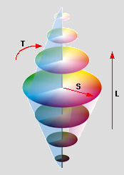
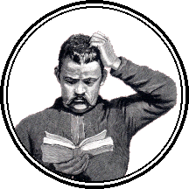
The transformation of the RGB colour space to a hue, saturation and brightness colour space is essentially a conversion from a set of rectangular coordinates to a set of (3D-polar) cylindrical coordinates.
H
triangle
Yet there are many such spaces described in books.
How does one choose which one to use?
HSI
HSV
HLS
IHS

Slide 14
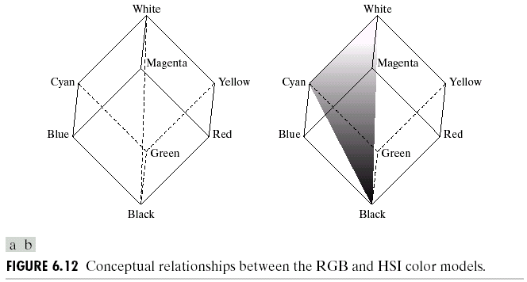
Color Models -- HSI Model

Slide 15
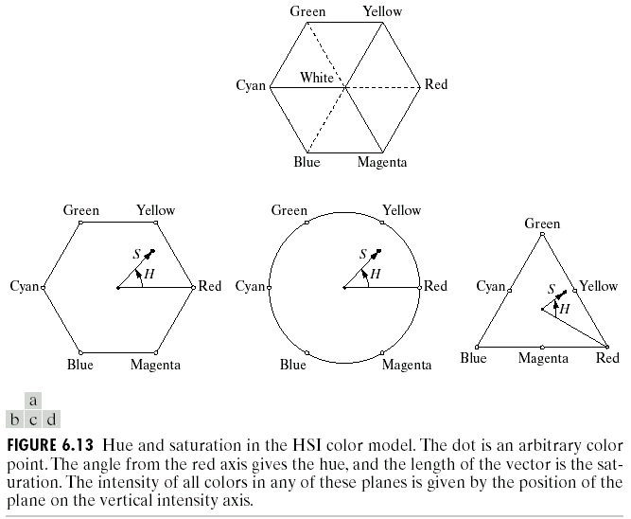
Color Models -- HSI Model

Slide 16
Color Models -- HSI Model

Slide 17
Color Models -- HSI Model

Slide 18
Color Models -- HSI Model
Converting colors from RGB to HSI

Slide 19
Color Models -- HSI Model
Converting colors from HSI to RGB
RG sector ( )
GB sector ( )
BR sector (

Slide 20
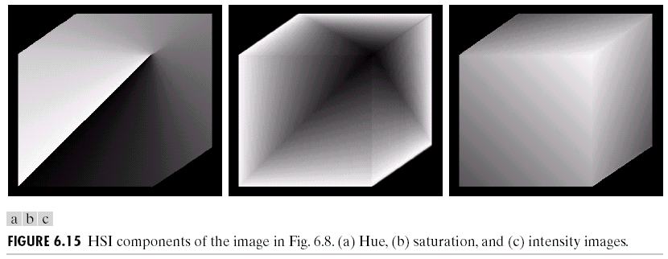
Color Models -- HSI Model

Slide 21
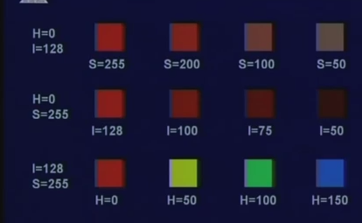
HSI property

Slide 22
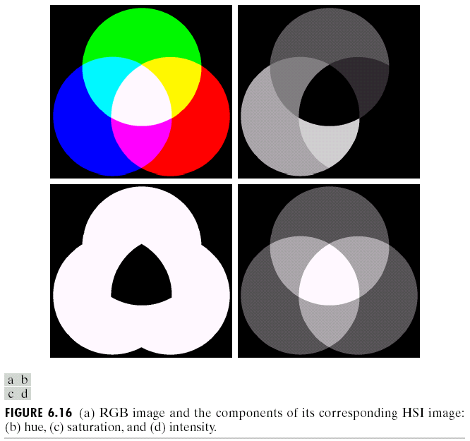
Color Models -- HSI Model

Slide 23
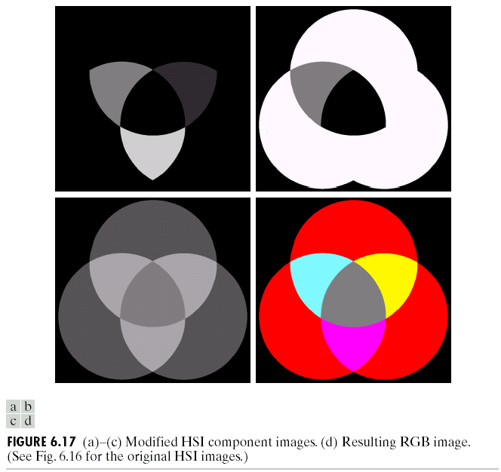
Color Models -- HSI Model

Slide 24
Color image processing
Pseudo-color image processing
Assign color to monochrome images
Intensity slicing
Gray level to color transformation
Spatial domain approach – three different transformation functions
Frequency domain approach – three different filters
Full-color image processing
Color image enhancement and restoration
Color compensation

Slide 25
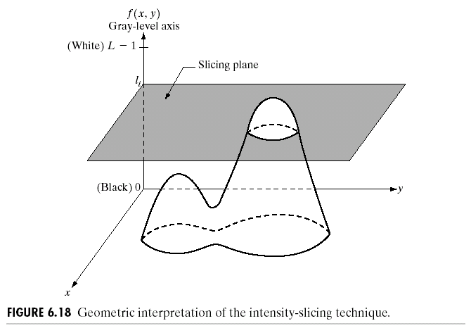
Pseudocolor Image Processing
Intensity Slicing
The pseudocolors used to colorize a gray level image do not represent the original, true colors if there were originally a color image.

Slide 26
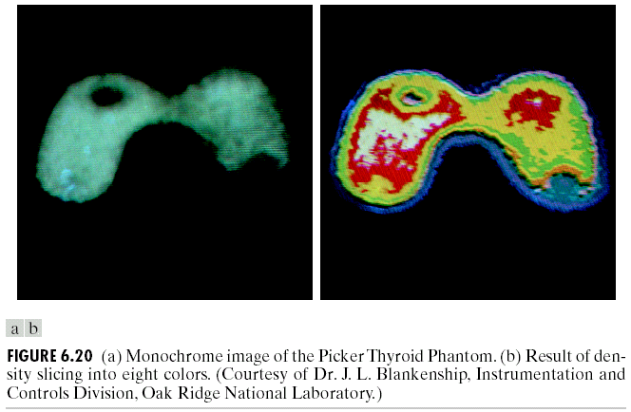
Pseudocolor Image Processing
Intensity Slicing

Slide 27
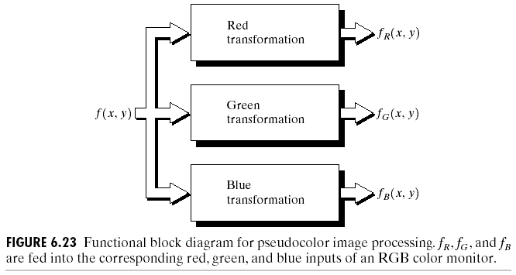
Gray level to color transformation – spatial domain
Perform three independent transformations on the gray level of any input pixel.
The three results can then serve as the red, green, and blue components of a color image

Slide 28
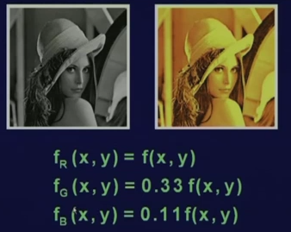
How its done?

Slide 29
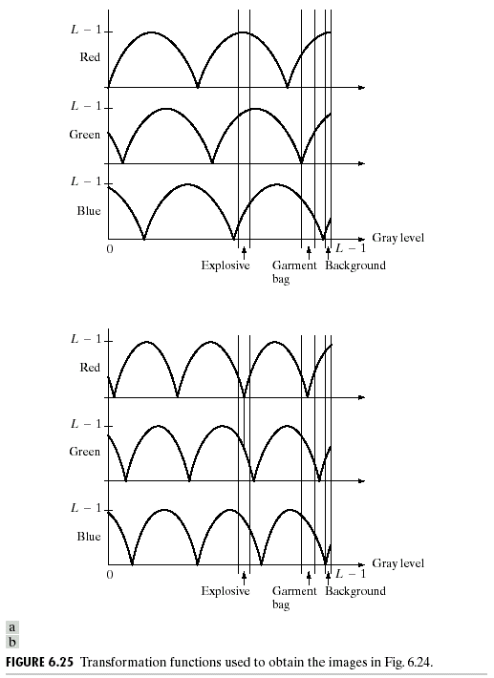
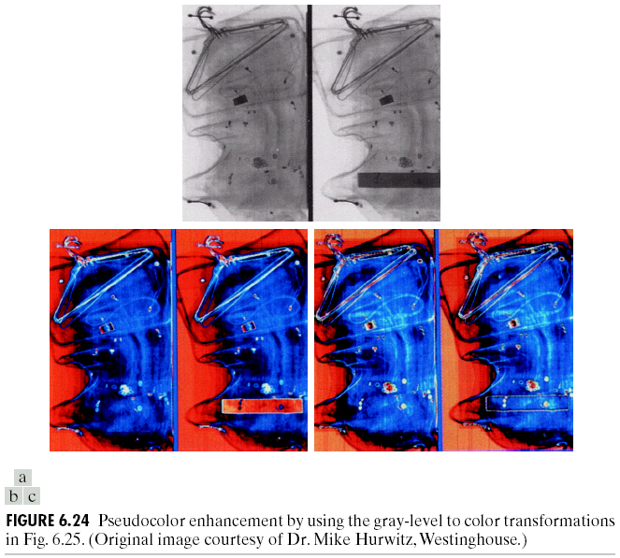
Examples

Slide 30
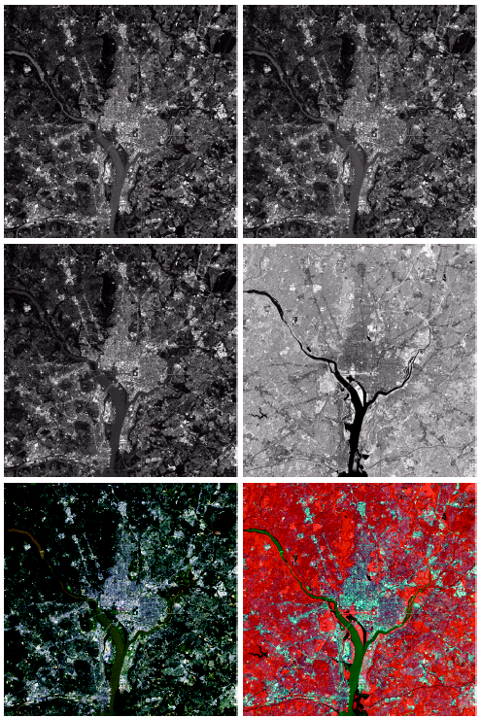
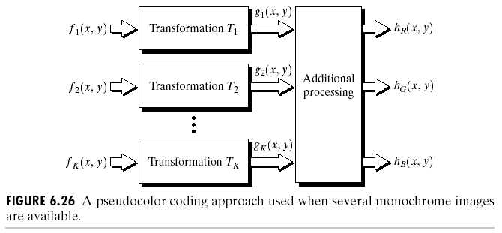
Example 2

Slide 31
Full Color Image Processing
Two processing methods:
(1) process each channel (or color component) separately, as if the color image were three gray scale images; (Color Transformations)
(2) process all channels with each pixel represented as a vector. (vector processing
Color transformations
Processing in RGB, HSI, or CMY(K) space

Slide 32
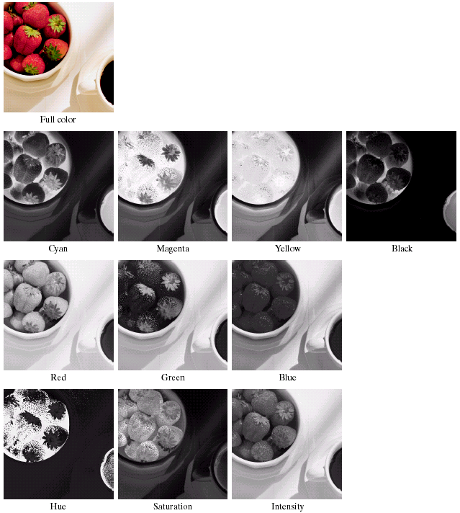
Color Transformations
RGB<->HSI<->CMYK

Slide 33
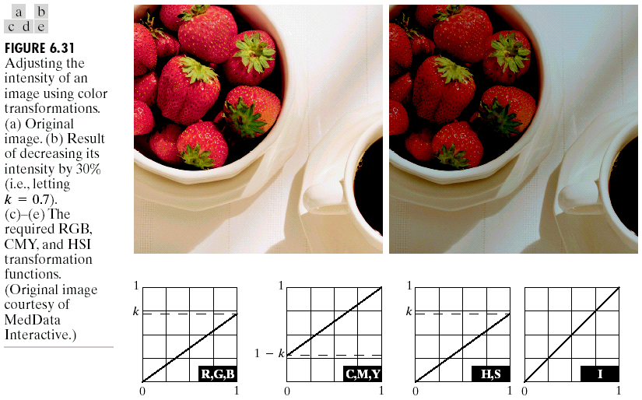
Color Transformations
Example

Slide 34
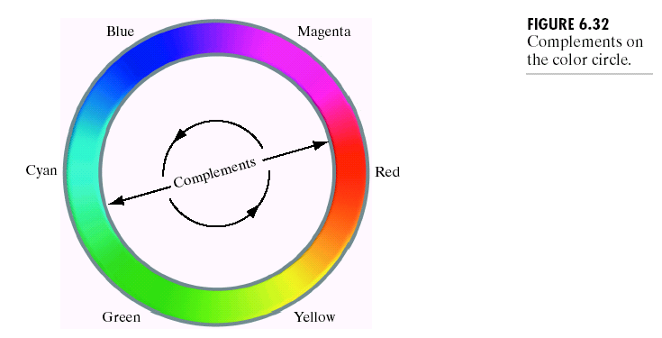
Color Complement Transformations
To the human visual system, colors have complements.
Complements are basically given by subtracting one color from white, or by changing a hue by 180 degrees.

Slide 35
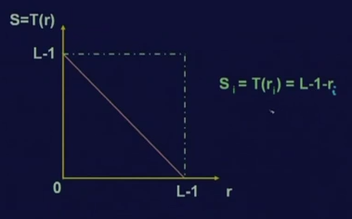

Slide 36
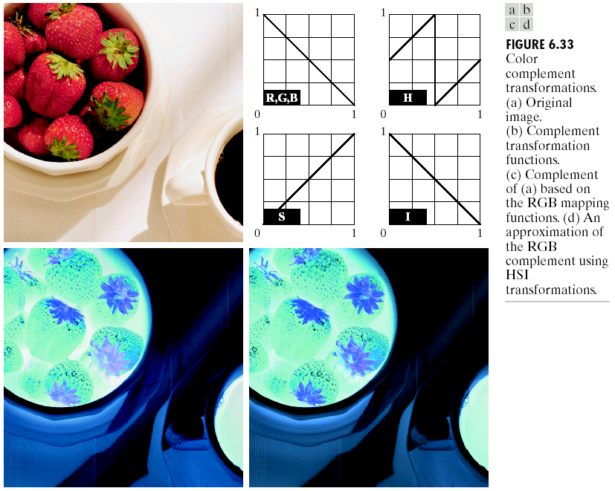
Color Complement Transformations
Example

Slide 37
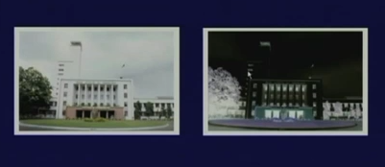

Slide 38
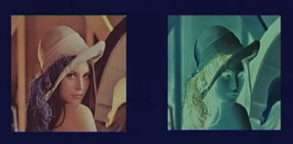
Transformation to red, green and blue components

Slide 39
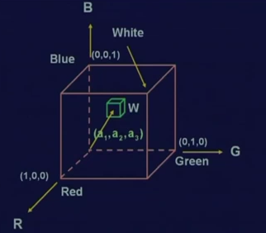
color slicing

Slide 40
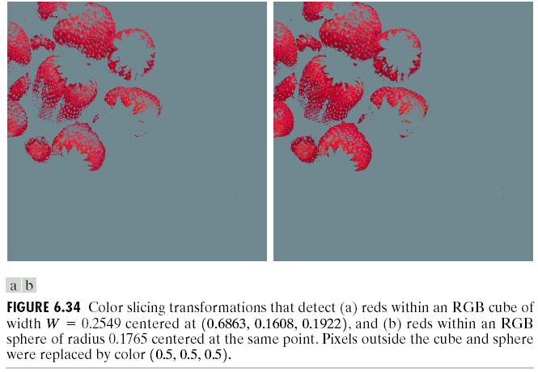
Color Slicing
Example
Color slicing: highlighting a specific range of colors in an image.

Slide 41
Tone correction
For a color images, we define the tone. So, a color image may have a flat tone, it may have a light tone or it may have a dark tone
These tones are determined by the distribution of the intensity values of different RGB components within the image.

Slide 42
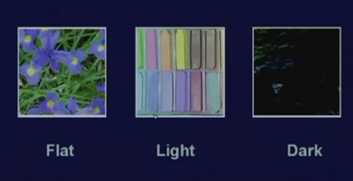

Slide 43
Tone and Color Corrections
Tone Corrections

Slide 44
Tone and Color Corrections
Tone Corrections

Slide 45
Tone and Color Corrections
Tone Corrections

Slide 46
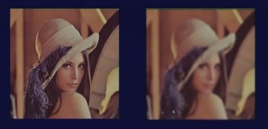
neighborhood processing technique Smoothing

Slide 47
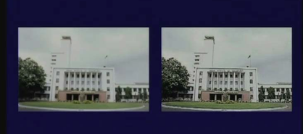
Sharpening

Slide 48
Summery of the lecture
RGB color model
CMY model
HSI color model
Pseudocolors image processing
Full color image processing

Slide 49
References
Prof .P. K. Biswas Department of Electronics and Electrical Communication Engineering Indian Institute of Technology, Kharagpur
Gonzalez R. C. & Woods R.E. (2008). Digital Image Processing. Prentice Hall.
Forsyth, D. A. & Ponce, J. (2011).Computer Vision: A Modern Approach. Pearson Education.

